Slide 1

8-Puzzle Problem

Slide 2
Our Team
Toka fawzy
Mariam Fasile
Mennah Ragab
Mariam Ehab
Implement the problem with A*
Implement the problem with IDS
Implement the problem with BFS
Implement the problem with GBFS

Slide 3
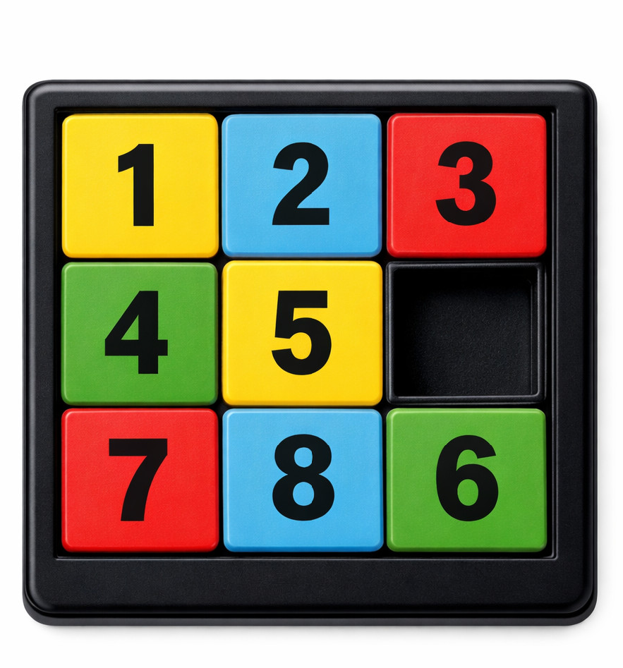
Problem Description
The 8 Puzzle Problem is a classic problem in artificial intelligence (AI) and is often used to teach problem-solving techniques, particularly in the areas of search algorithms and heuristic optimization.
It consists of a 3x3 grid with 8 numbered tiles and one empty space.

Slide 4
Problem Representation
the 8 Puzzle Problem is typically represented as a state space problem
Initial State
Start location of 8 tiles
Action
Direction of moves
Goal state
arrange the tiles in a specific order with the blank space at the bottom right.
Goal Test
Check if current state match goal state
Cost
Each move has a uniform cost, typically 1 per move, making this an instance of a uniform cost search problem.

Slide 5

Solve Problem with BFS
BFS explores puzzle states level by level
starting from the initial state. Each state represents a different arrangement of the tiles.
Uses a queue (FIFO) to store states. Guarantees the shortest solution (minimum number of moves).
Disadvantage: Consumes large memory because it stores many puzzle states.

Slide 6

Solve Problem with GBFS
GBFS selects the next state based only on the heuristic value h(n).
Always expands the state that appears
closest to the goal.
Uses a priority queue ordered by the heuristic.
Advantage: Faster than BFS in many cases.
Disadvantage: Does not guarantee the shortest solution and may get stuck in local minima.

Slide 7

Solve Problem with IDS
IDS (Iterative Deepening Search) combines DFS memory efficiency with BFS optimality.
Repeatedly applies Depth-Limited Search
with increasing depth limits. Explores puzzle states up to a certain depth, then increases the limit.
Guarantees the shortest solution when all moves have equal cost.
Advantage: Uses less memory than BFS. Disadvantage: Repeats node expansions, which increases time.

Slide 8

Solve Problem with A*
A* is a heuristic search algorithm that selects the most promising state first. It uses the evaluation function:
f(n) = g(n) + h(n)
g(n): Cost from start to current state h(n): Estimated cost to reach the goal Heuristic Used: Manhattan Distance
Sum of grid distances of each tile from its goal position.
Advantage: Guarantees the shortest path with an admissible heuristic.
Disadvantage: Performance depends on the quality of the heuristic.

Slide 9
Comparison
 | BFS | GBFS | IDS | A*
Complete | Yes | No | Yes | Yes
Optimal | Yes | No | Yes | Yes
Time Complexity | Slow | Fastest | Slowest | Efficient
Space Complexity | High | Medium | Low | Medium
Steps | High | Highest | Low | Lowest

Slide 10
Why A * is the Best
Maximum Efficiency: It achieved the goal in the fewest steps (2 steps). Heuristic Intelligence: Unlike "blind" searches (BFS/IDS), A* uses the Manhattan Distance to estimate the distance to the goal, allowing it to ignore irrelevant paths.
Guaranteed Quality: It is both Complete (always finds a solution) and Optimal
(always finds the shortest path).
Optimal Balance: It provides a better balance between Time Complexity and
Space Complexity compared to BFS, which can easily exhaust memory.

Slide 11

Thank You

